Slide 1
NLP Chatbot Development using Dialogflow
Name: Saleha Shaukat
Group ID: F24PROJECT38A67 (BC230424569)

Slide 2
GitHub link: https://github.com/Saleha786-collab/Prototype-Assignment--Saleha-Shaukat_BC230424569-.git
Date: 13 March 2025
Supervisor: Abdullah Qamar

Slide 3
Slide 1: Introduction:
Purpose:
This chatbot is designed to enhance customer service for a restaurant by automating responses to common customer inquiries, reducing wait times, and providing real-time order updates and product information.
Scope:
Key Features:
General Greeting
Order Status Check
Product-Related FAQs
Support Ticket Creation
Conversation Closure
Authentication and Authorization
Profile Management

Slide 4
Slide 2: Explanation of Features
General Greeting:
The chatbot greets users with a friendly message to set a welcoming tone for the conversation.
Order Status Check:
Users can check their order status in real-time, with updates on delivery or pickup times for better transparency.
Product-Related FAQs:
The chatbot answers common questions about the product stock and product price,
providing quick and easy information.
Support Ticket Creation:

Slide 5
For complex issues, users can create support tickets that are escalated to human agents for further assistance.
Conversation Closure:
The chatbot politely ends conversations, ensuring users feel satisfied and informed before closing the interaction.
Authentication and Authorization:
Users will register and log in, with role-based access control to provide different user types with appropriate permissions.
Profile Management:
Users can manage their profiles (view and update personal information), and the chatbot will retrieve relevant user data based on their profile.

Slide 6
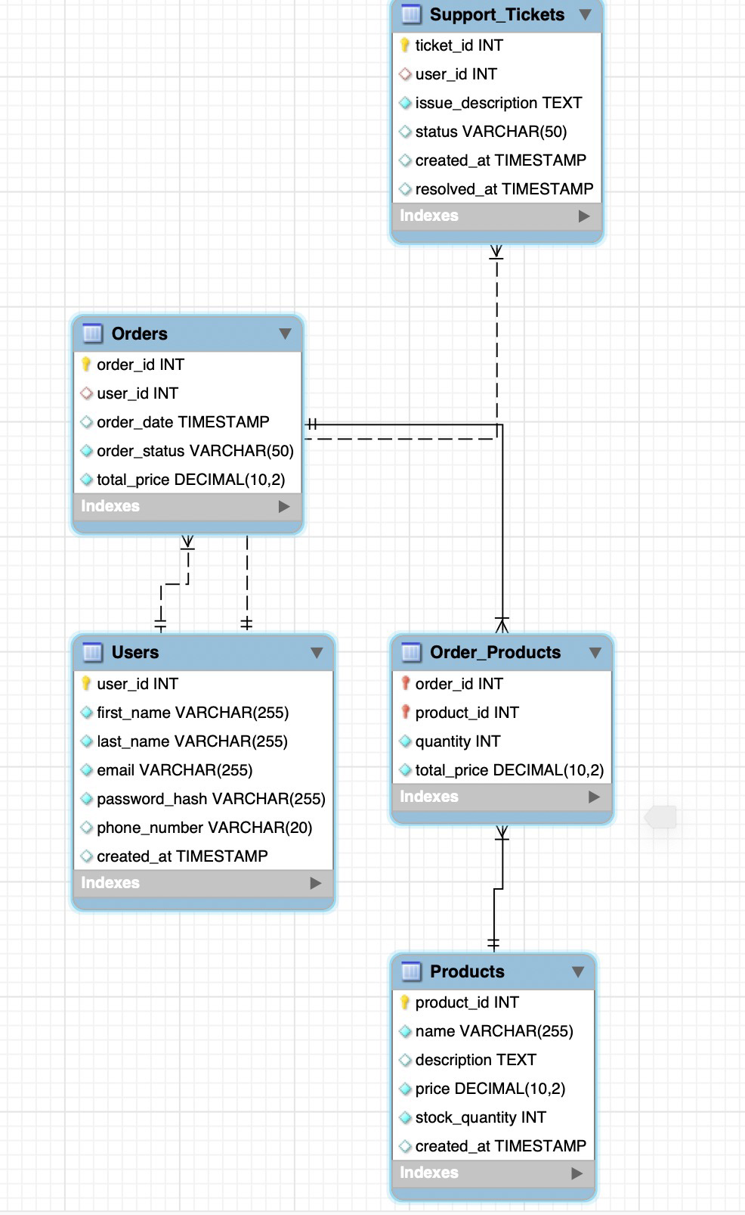
Slide 3: Database Schema
Overview: The database is structured to support multiple functionalities.
Tables: Users, Orders, Products, Support Tickets.
Key Constraints: Ensure data consistency and proper relationships.
Relationship Explanation: Describes how the tables link (e.g., Orders linked to Users, Products linked to Orders).

Slide 7
Slide 4: Dialogflow Integration
Intents and Entities:
Intents: Group user queries (e.g., order status, product inquiry).
Entities: Extract specific details (e.g., product name, order ID).
Flow Design:
How user input is mapped to chatbot actions.

Slide 8
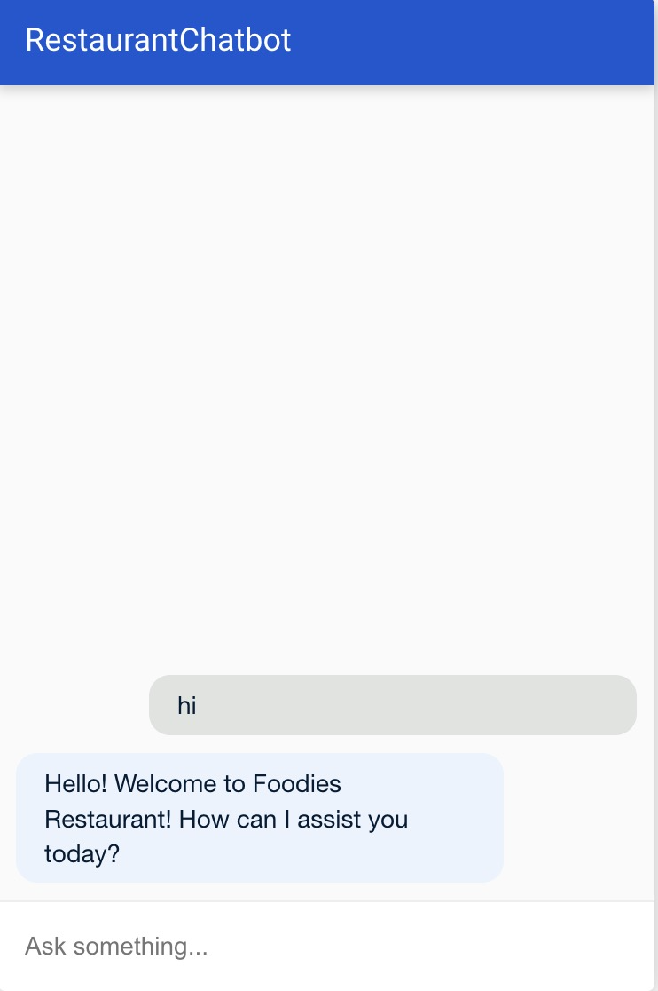
Slide 5: Chatbot Flow - Greeting & Onboarding
User Inputs: “Hello,” “Hi,” “Hey”
Chatbot Response: “Hello! Welcome to [Restaurant Name]. How can I assist you today?”
Logic/Condition: If no input after a few seconds, prompt user again.

Slide 9
Slide 6: Chatbot Flow - Main Menu / Intent Identification
User Inputs: “I want to check my order status,” “Product price?”
Chatbot Response: Requests order ID or product details.
Logic: Identifies the user's intent and routes them to the relevant flow (Order Status, Product Info, Support).

Slide 10
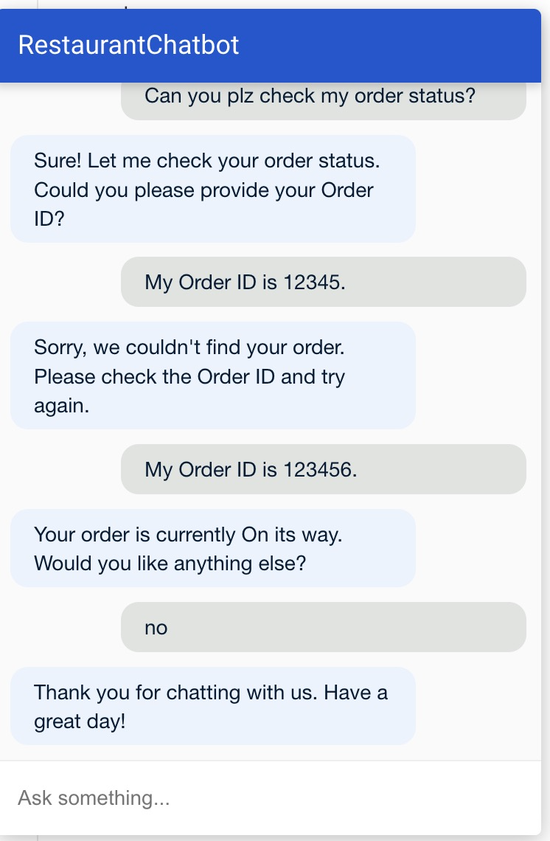
Slide 7: Order Status Flow
User Possible Inputs:
“I want to check my order status.”
“Where is my order?”
“My order is delayed.”
“Order status?”
Bot Asks for Details
Bot: “Sure! Let me check your order status. Could you please provide your Order ID or email address associated with the order?”
Bot Fetches and Displays Order Status
The chatbot uses the provided Order ID or email address to retrieve order information from the database.
Bot: “Your order is currently [Order Status]. Expected delivery time is [Time]. Is there anything else I can help you with?”

Slide 11
Next Steps
User's Response:
Option 1: End the conversation: User: “No, that’s all.” Bot: “Thank you for using our service! Have a great day.”
Option 2: Ask another question: User: “I have another question.” Bot: Routes the conversation to the appropriate flow (e.g., Product Inquiry or Support Ticket Creation).

Slide 12
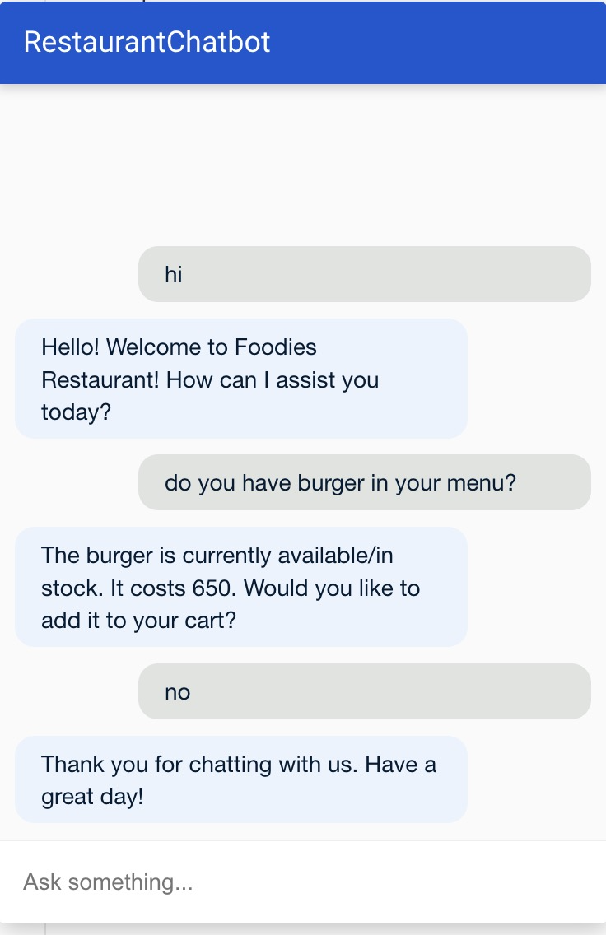
Slide 8: Product Information Flow
User Possible Inputs:
“I have a question about a product.”
“Is product X in stock?”
”How much is product Y?”
Bot Requests Product Details
Bot: "Which product would you like to know more about?"
User Specifies Product
User: "I want to know if the [Product Name] is in stock."
Bot Fetches Product Data
If In Stock:

Slide 13
Step 4: Confirmation & Next Step
Possible User Responses:
Yes, add to my cart:
Bot: "Great! It’s in your cart. Anything else you need?" → Return to Main Menu or end conversation.
No, just checking:
Bot: "Understood. Anything else I can help you with?" → Return to Main Menu.
Bot: "The [Product Name] is currently available/in stock. It costs [Price]. Would you like to add it to your cart?"
If Out of Stock:
Bot: "Currently, the [Product Name] is out of stock. Would you like me to notify you when it’s back?"

Slide 14
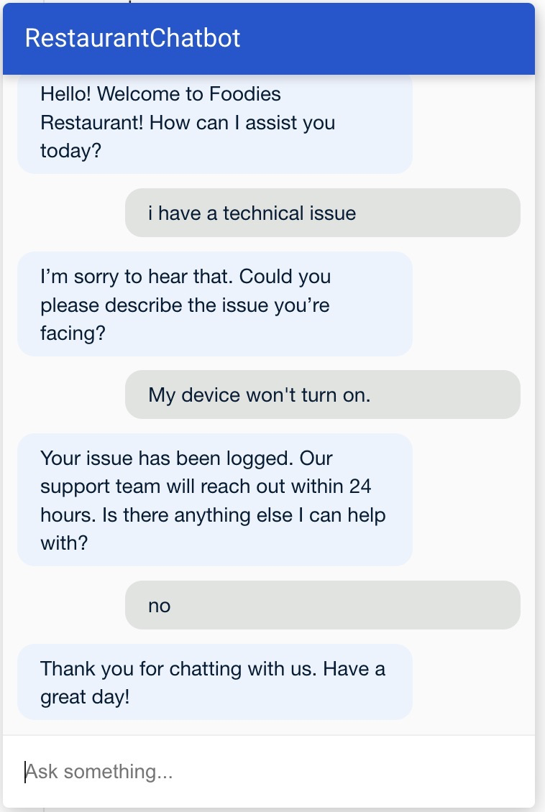
Slide 9: Technical Support Flow
User Possible Inputs:
“My device is not working.” “I need help with my account.” “I have a technical issue.”
Bot Gathers Issue Details
Bot: "Could you please describe the issue you're facing?"
User Describes the Issue
User: "My device won’t turn on."
Bot Troubleshoots or Escalates
Bot: "I’m sorry to hear that. Let’s try some basic troubleshooting steps. Have you tried resetting the device by holding the power button for 10 seconds?"

Slide 15
User Response
If Resolved:
User: "Thanks, it works now!"
Bot: "Glad to hear! Anything else I can help with?" → Return to Main Menu or end conversation.
Bot: "Glad to hear! Anything else I can help with?" → Return to Main Menu or end conversation.
If Not Resolved:
User: "Still not working."
Bot: "I’ll create a support ticket for further assistance. Can you confirm your email address and preferred contact method?"
Bot Confirms Ticket Creation
Bot: "Your ticket has been created. Our support team will reach out within 24 hours. Is there anything else you need?" → Return to Main Menu or end conversation.

Slide 16
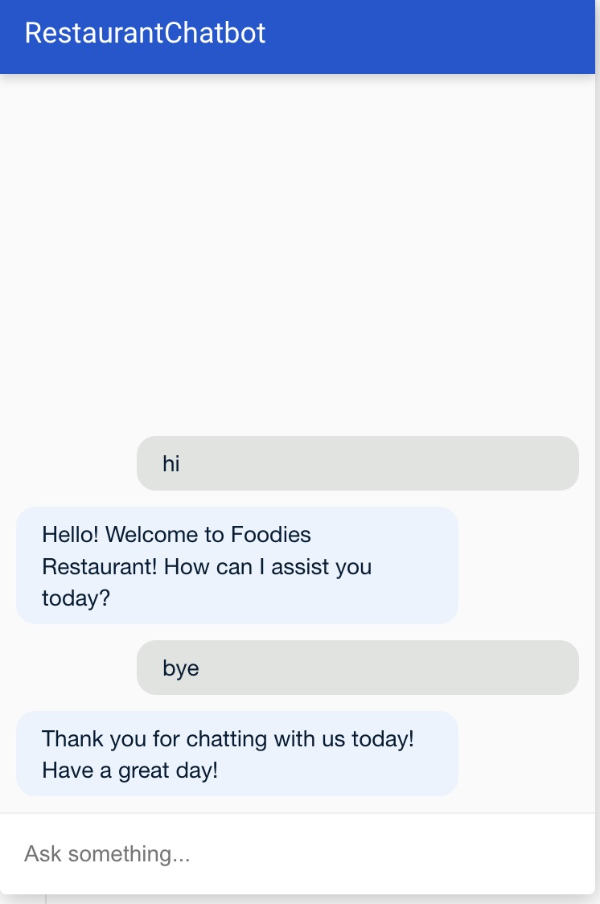
Slide 10: Closing Conversation Flow
User Possible Inputs:
"Bye"
"No, thank you"
"That’s all"
Chatbot Response:
"Thank you for chatting with us today! Have a great day!"
Logic/Condition:
If the user explicitly says goodbye or indicates no further questions, the chatbot will end the conversation gracefully.

Slide 17
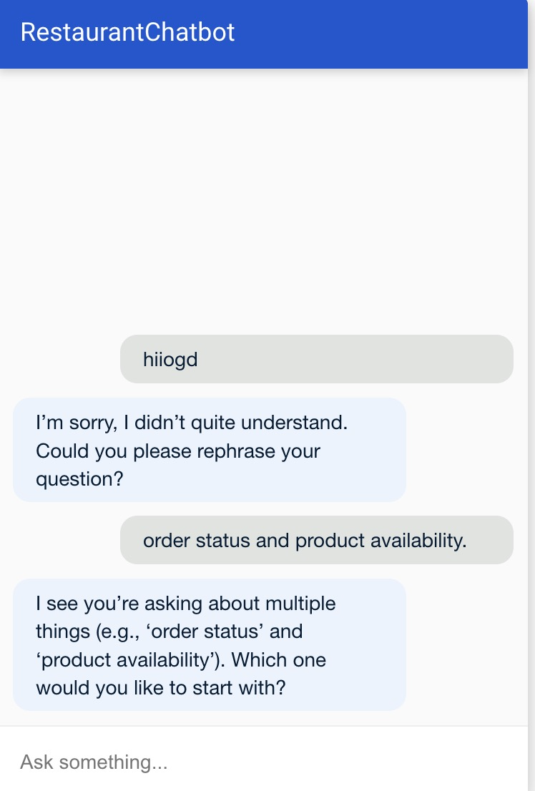
Slide 11: Error Handling & Fallbacks
Unrecognized Input: “Sorry, I didn’t understand. Could you rephrase?”
Multiple Intents Detected: Clarify which question to address first.
Invalid Input: Handle misformatted data (e.g., invalid order ID).

Slide 18
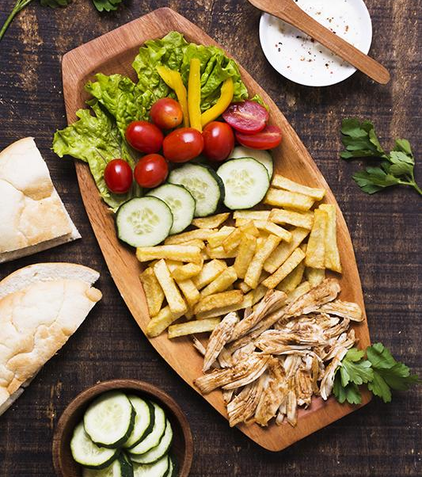
Slide 12: Future Work
Completing the remaining features and polishing the UI.
Plans to expand chatbot functionality (e.g., adding more intents, improving support features).

